Slide 1
GOVERNMENT DATASET
District-wise stage teacher -pupil ratio of 9 to 10 from 1989 to 2022(as on 30th September)
Source: https://www.data.gov.in/

Slide 2
INTRODUCTION
This presentation provides an analysis of the District-wise stage teacher -pupil ratio of 9 to 10 from 1989 to 2022(as on 30th September)
It includes the Distribution of the teachers over the years.

Slide 3
OVERVIEW OF THE DATASET
The dataset shows the teacher-student ratio across different districts from 1989 to 2022. It tracks how the ratio has changed over time, indicating trends in class sizes. In the earlier years, the ratio was generally higher, meaning more students per teacher, while in recent years, the ratio has improved, suggesting smaller class sizes. The teacher-student ratio varies between 9 and 40, with an average of 19.7 in 2022. The highest recorded ratio is 40 (in 1990), while the lowest is 9 (in recent years), indicating a possible improvement in the teacher student ratio over time. In general, the ratios from the 1990s were significantly higher, often exceeding 25, suggesting that class sizes may have been larger in the past compared to recent years.

Slide 4
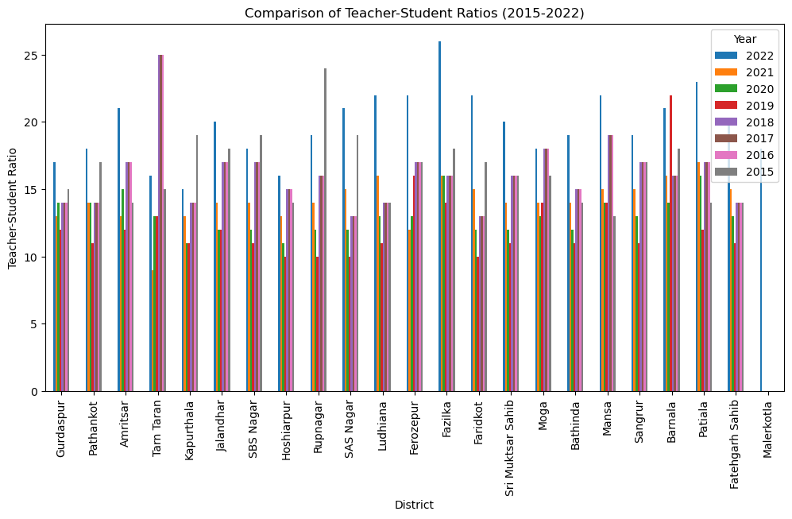
The above comparison shows the increasing and decreasing of the teacher-student ratio over the years.

Slide 5
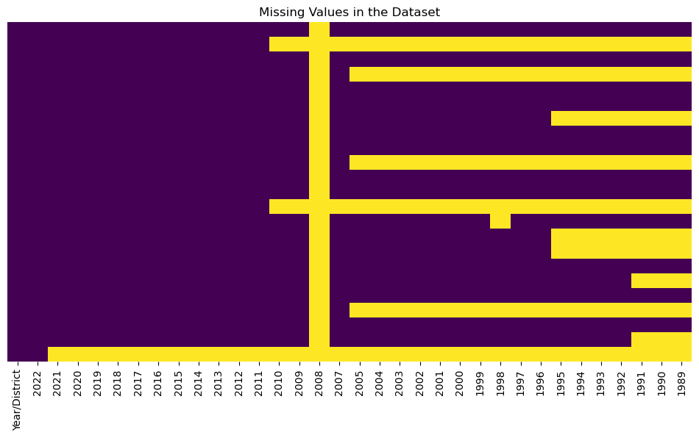
The above heatmap shows the missing values means the years that there is no students for the teacher.

Slide 6
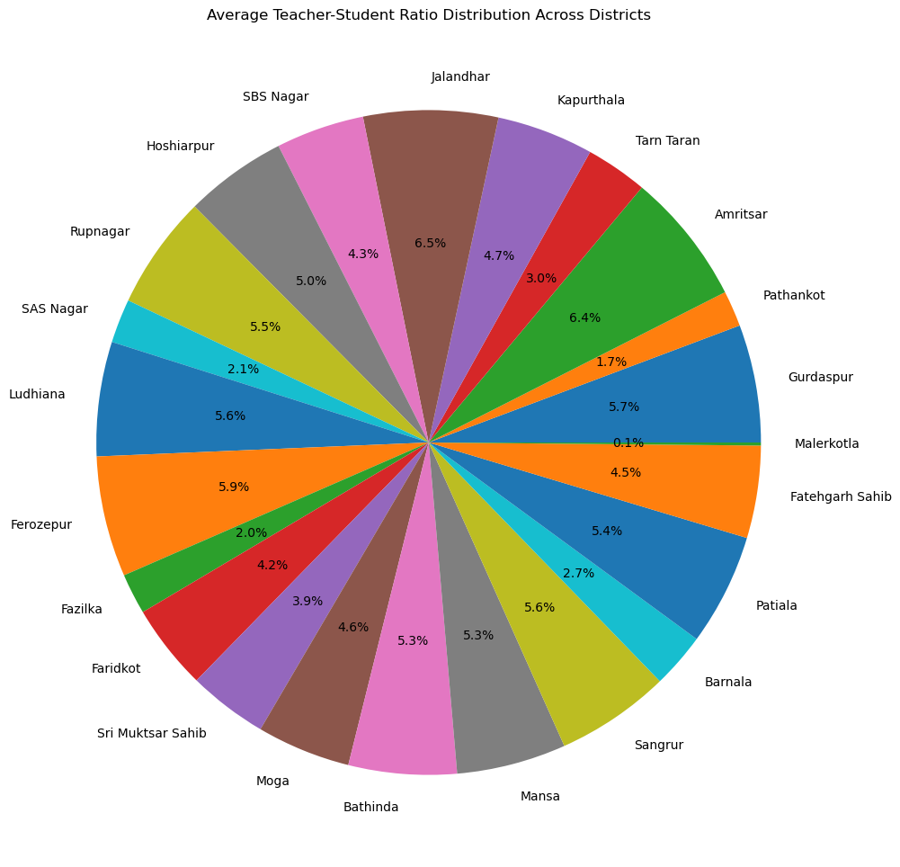
The pie chart shows the average teacher-student ratio distribution across the districts.

Slide 7
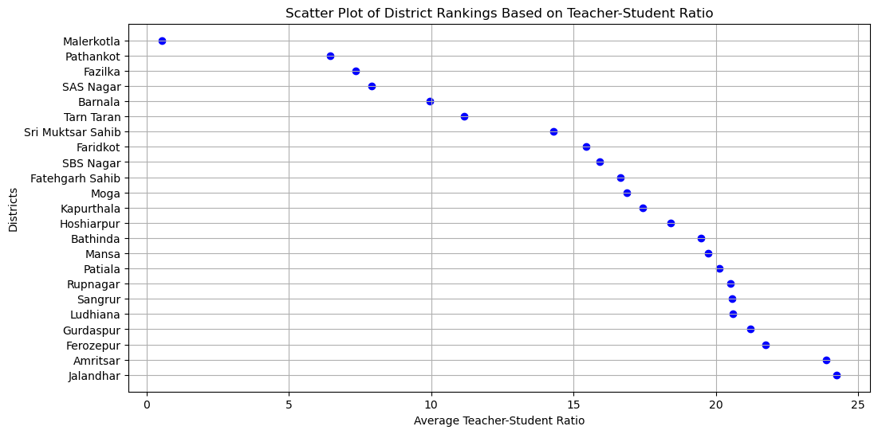
Here is the ranking of the districts based on teacher-student ratio from lowest to highest means Jalandhar district has the most number of students per teacher.

Slide 8
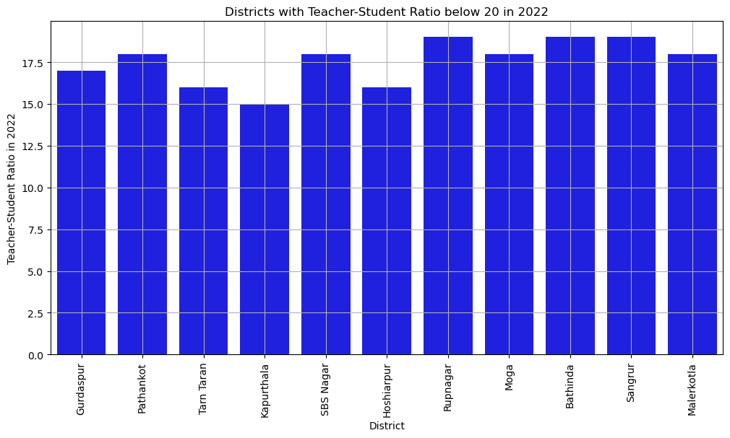
It shows the availability of the teachers to the students because the ratio is maximum 17 students per year.

Slide 9
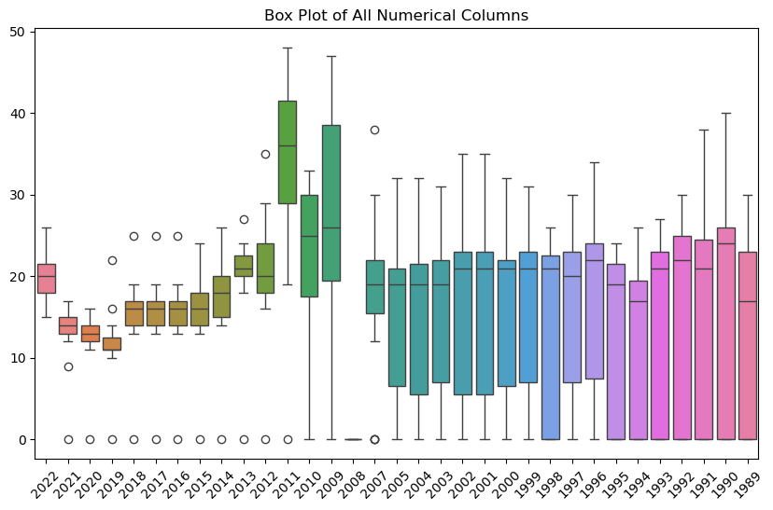
The box plot visualizes the distribution of numerical data over various years.

Slide 10
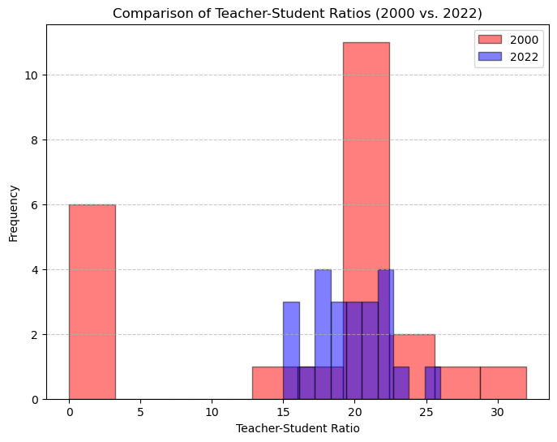
This histogram compares teacher-student ratios in 2000 (red bars) and 2022 (blue bars).

Slide 11
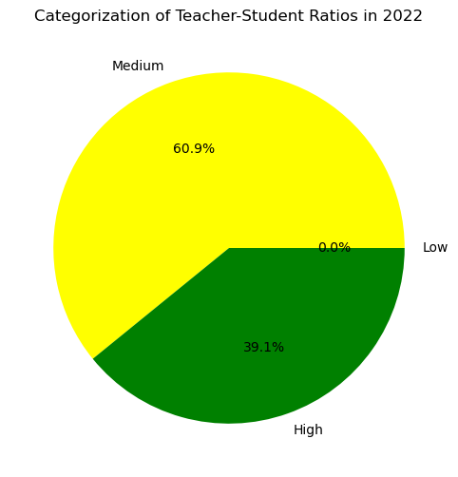
This pie chart categorizes teacher-student ratios in 2022 into three groups: "Low," "Medium," and "High."

Slide 12
Observations
In earlier years, the teacher-student ratio was higher, meaning more students per teacher.
In recent years, the ratio has improved, indicating smaller class sizes.
The ratio fluctuates over the years, but there is a general downward trend, showing improvement in teacher availability.
A lower ratio suggests better student-teacher interaction, which may lead to improved education quality over time.

Slide 13
Conclusion
The analysis of the dataset reveals a significant improvement in the teacher-student ratio over time, with a clear trend of smaller class sizes in recent years. This suggests a better allocation of educational resources and increased teacher availability, leading to potentially improved student-teacher interaction and education quality. While earlier years had ratios often exceeding 25, indicating overcrowded classrooms, the current average of 19.7 in 2022 reflects progress towards more manageable class sizes.

